Slide 1


Cybersecurity Log Monitoring System
Real-Time Threat Detection & Analytics Platform
Python
Apache Spark
Snowflake
SQL & BI Tools
Team Members: Rajaram Parida, Madhumita Parida, Pragyan Paramita | Institution: Institute of Technical Education and Research (ITER), SOA | Date: 25.02.2026

Slide 2
Problem Statement & Objectives
Problem
Objectives
Modern organizations face an overwhelming influx of log data daily. Manually sifting through this volume is not only inefficient but also prone to human error, leading to critical delays in identifying and responding to cyber threats.
Our platform aims to automate and optimize the entire process of cybersecurity log management, from ingestion to intelligent analysis.
Monitor & analyze cybersecurity logs in real-time
Detect suspicious high-severity events proactively
Build optimized Data Warehouse (Star & Snowflake Schema)
Implement robust, secure access controls
Provide interactive dashboards for actionable insights
Massive log data generation
Inefficient manual monitoring
Delayed threat detection
Increased security vulnerabilities

Slide 3
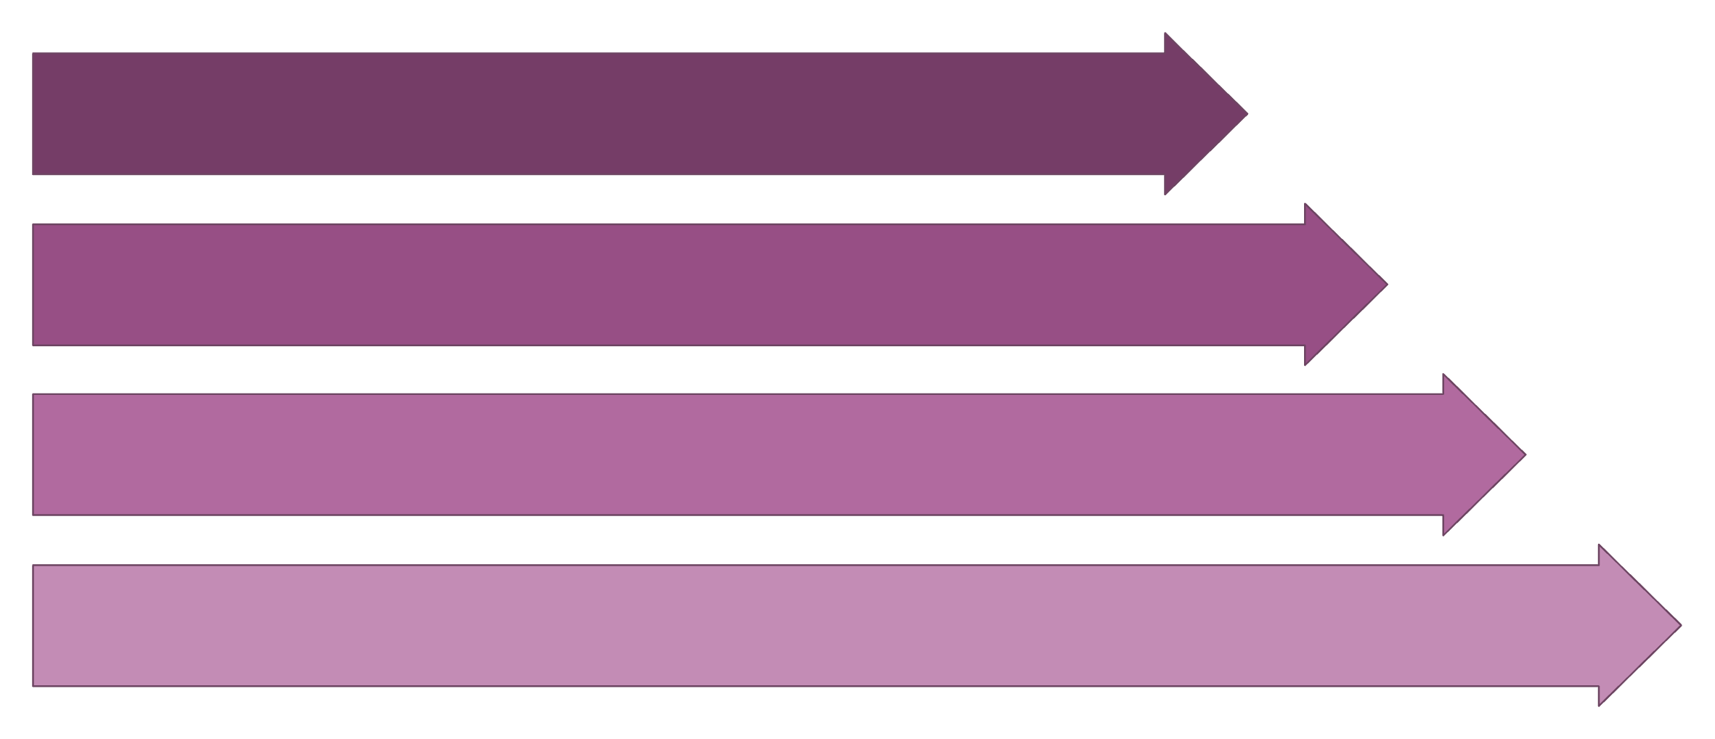
System Architecture
Data Sources
ETL (Python)
Apache Spark
Snowflake
This architecture ensures a seamless flow of data from diverse sources through robust processing engines to a secure and analytical data warehouse, culminating in intuitive dashboards for threat intelligence.
Core Components from Project Structure
etl/
spark/
sql/
Extract, Transform, Load scripts
Batch & Streaming processing
Schema definitions & advanced queries
dashboard/
security/
Interactive visualizations
Access controls & policies

Slide 4
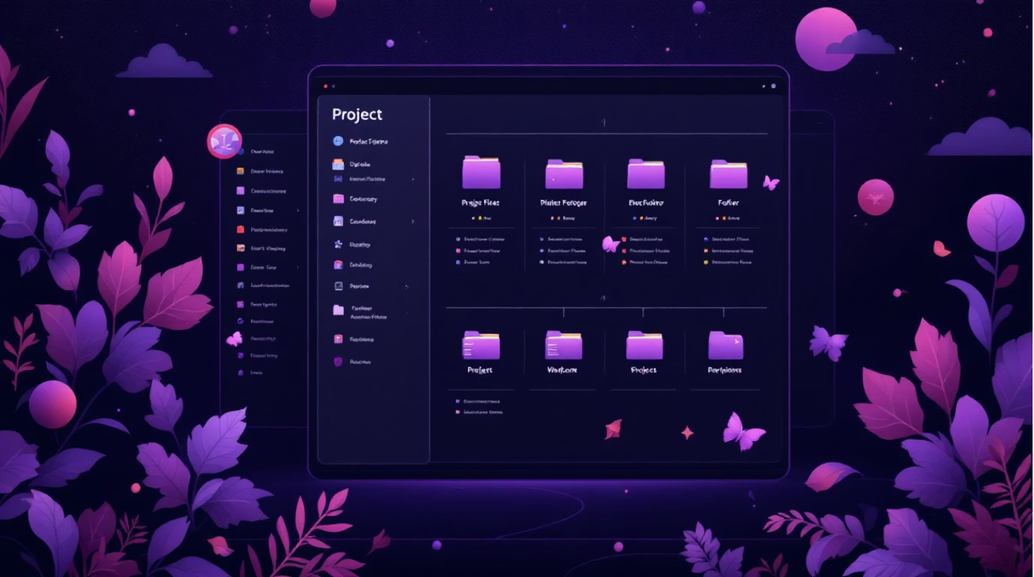
Project Folder Structure
cybersecurity-log-monitoring-system/
│
├── docs/
├── etl/
├── spark/
├── sql/
├── dashboard/
├── security/
├── requirements.txt
└── README.md
Design Philosophy
A production-ready repository structure designed for clarity and scalability.
Modular Architecture
Clear Separation of Concerns
Scalable & Maintainable
Each component is designed independently, allowing for easier updates and maintenance without affecting the entire system.
Different functionalities (ETL, Spark processing, SQL, etc.) are isolated into distinct modules, improving readability and collaboration.
The structure supports horizontal scaling and simplifies the process of integrating new features or expanding data sources.

Slide 5
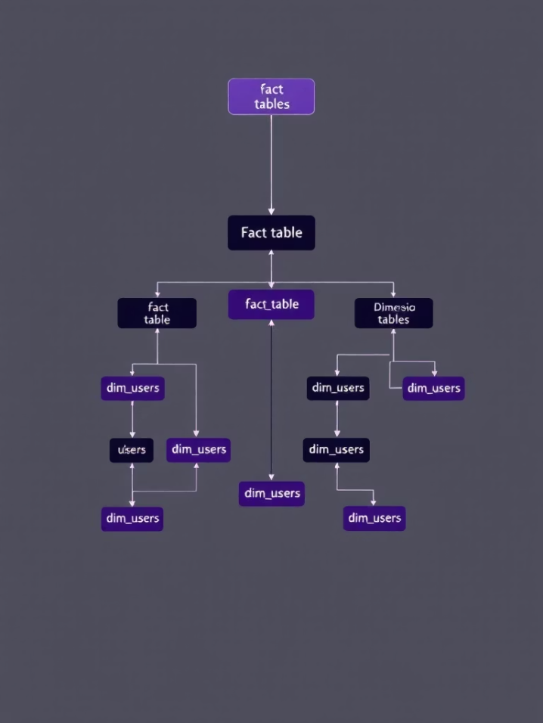
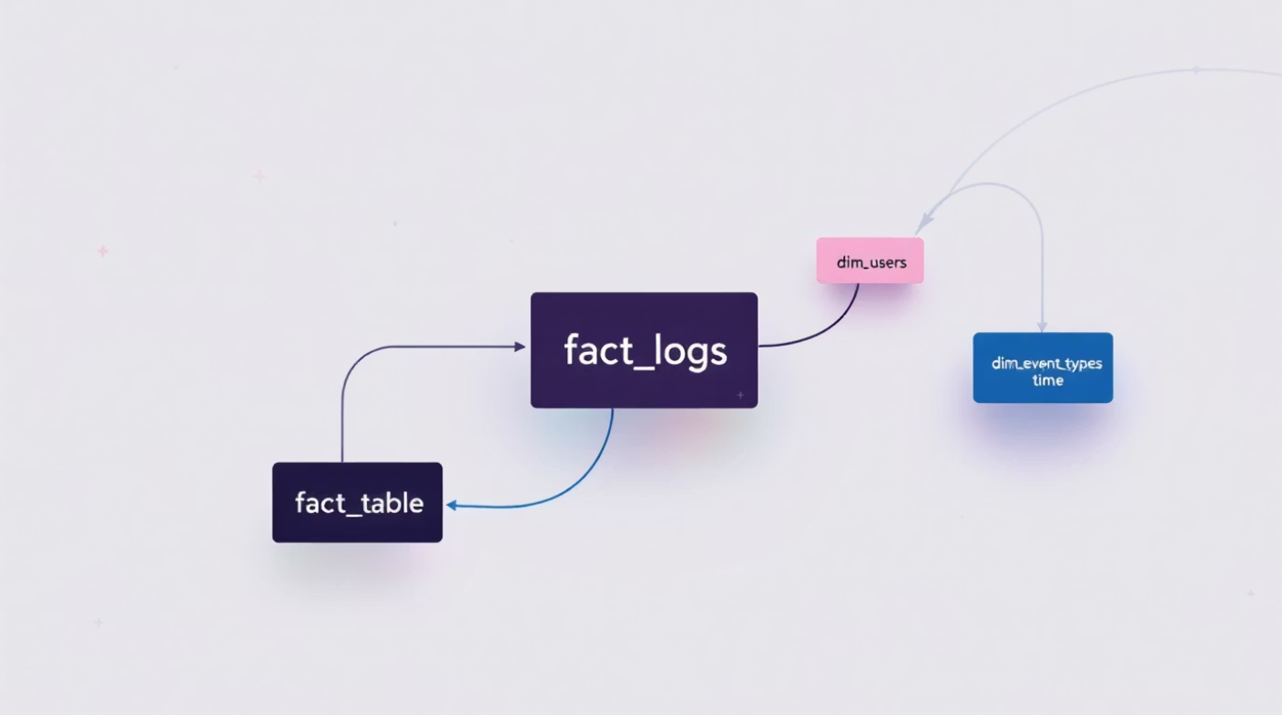
Data Warehouse Design
Snowflake Schema
Star Schema
fact_logs: Central table storing log event metrics.
dim_users: Details about users generating logs.
dim_event_types: Categorization of security events.
dim_time: Granular time-based dimensions.
Normalized Dimensions: Dimension tables are further normalized into sub-dimensions (e.g., dim_users linked to dim_user_roles).
Reduced Redundancy: Eliminates data duplication, enhancing data integrity.
Storage Optimization: Efficient use of storage space due to highly structured data.
Benefit: Optimizes for faster analytical queries and simplified reporting due to fewer joins.
Benefit: Ideal for complex analytical needs requiring high data integrity and minimal storage footprint.

Slide 6

ETL & Data Processing
Robust ETL Pipeline (etl/)
Extract
Transform
Reads raw security logs from various sources, supporting both JSON and CSV formats to accommodate diverse log types.
Cleanses data by handling missing fields, standardizes severity levels (e.g., critical, high, medium), and parses timestamps for consistent chronological analysis.
extract.py
transform.py
Load
Securely inserts processed and transformed data into the Snowflake Data Warehouse, preparing it for analysis and dashboarding.
load.py
This pipeline ensures data quality and prepares log information for effective threat detection and analysis.

Slide 7

Apache Spark Processing
Batch Processing
Streaming Processing
Leverages Spark's powerful batch capabilities for comprehensive analysis of historical log data.
Utilizes Spark Streaming to handle real-time log ingestion and immediate threat detection.
File: streaming_processing.py
Real-time ingestion from socket/Kafka
Instantaneous threat detection and alerts
Low-latency processing for critical events
File: batch_processing.py
Historical log analysis for long-term trends
Proactive severity trend detection
Identification of recurring attack patterns
Benefits: Distributed computing for immense scalability and a resilient architecture that handles both retrospective and immediate security intelligence needs.

Slide 8

Advanced SQL & Snowflake
SQL Capabilities (sql/)
Files: schema_star.sql, schema_snowflake.sql, advanced_queries.sql, optimization.sql
Advanced Techniques
Common Table Expressions (CTEs) for complex logic
Window Functions for analytical insights
Indexing & Partitioning for query performance
Snowflake Features
Clustering for optimized data retrieval
Time Travel for data recovery and audit
Semi-Structured Data support (JSON, Parquet)
Our project leverages Snowflake's powerful capabilities combined with advanced SQL techniques to ensure efficient data management, querying, and resilience for cybersecurity logs.

Slide 9

Security & Governance
Secure Implementation (security/)
File: snowflake_security.sql
Role-Based Access Control (RBAC)
Granular permissions ensure that only authorized users and roles can access sensitive log data, adhering to the principle of least privilege.
Data Masking for IP Addresses
Automatically obfuscates sensitive information like IP addresses to protect privacy and comply with data protection regulations.
Access Policies & Compliance
Enforces strict policies over data access and usage, ensuring that all operations are compliant with industry standards and legal requirements.
Outcome: Ensures secure data warehouse access, maintaining the confidentiality and integrity of all cybersecurity log information.

Slide 10
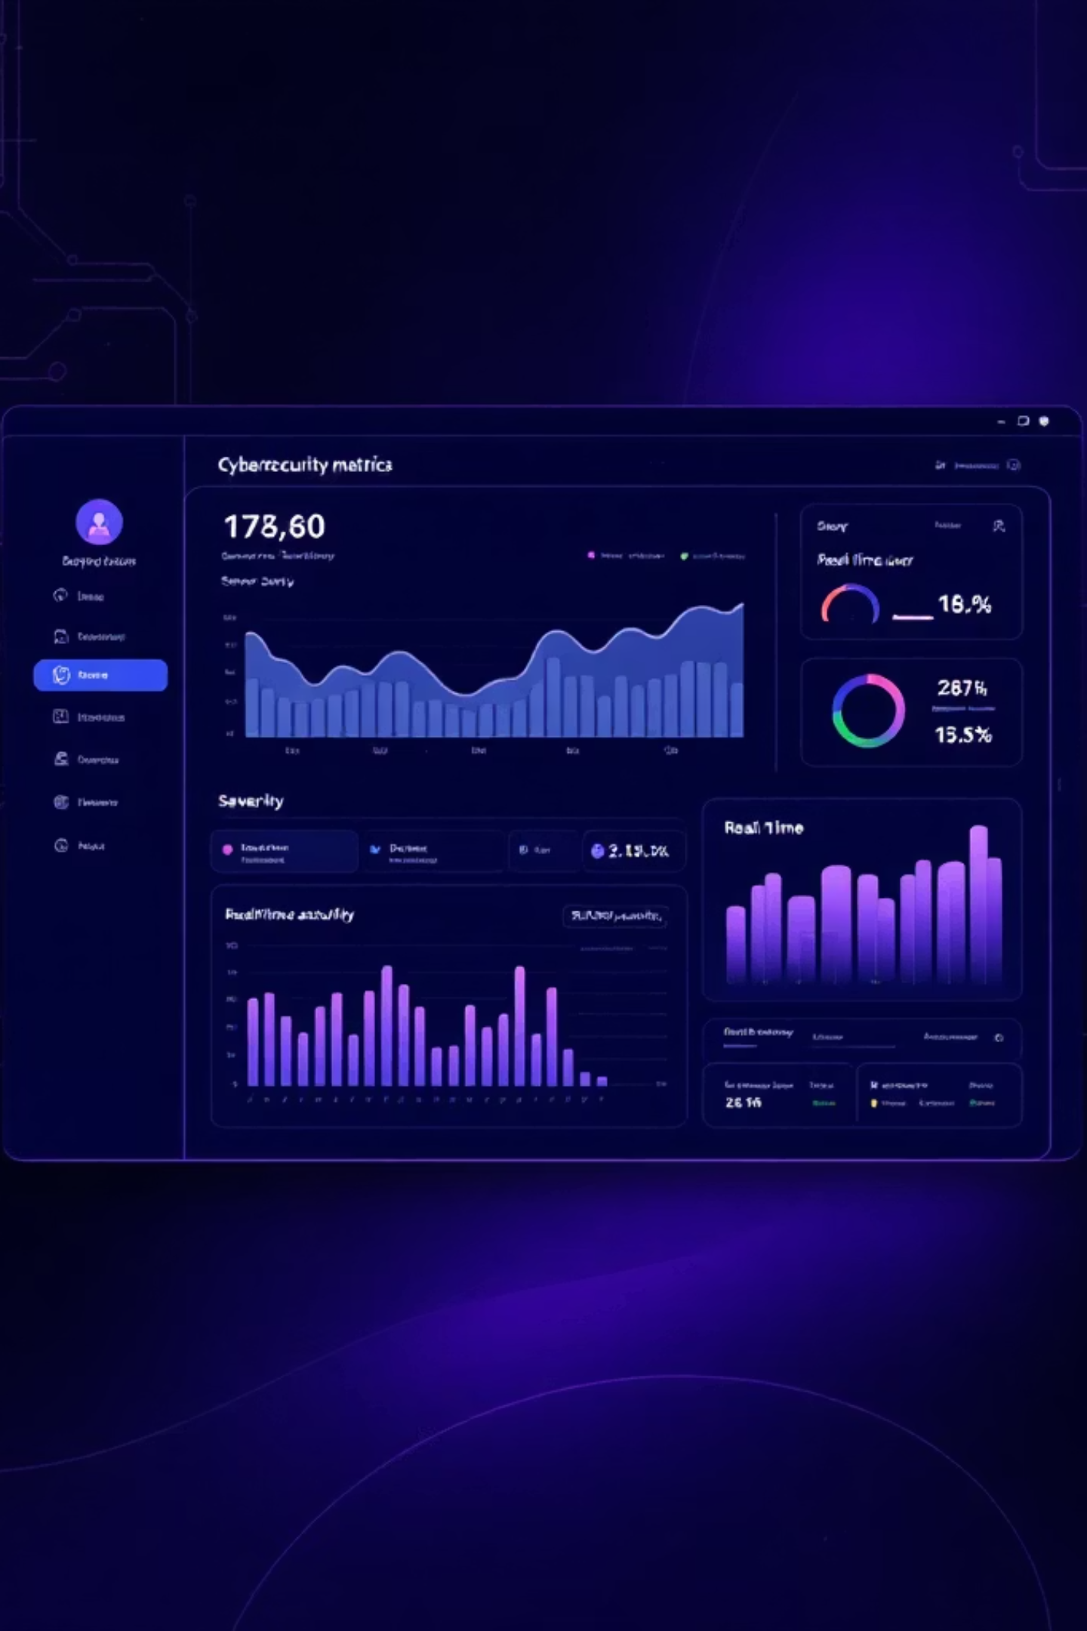
Dashboard, Results & Future Work
Interactive Dashboard (dashboard/)
Future Enhancements
Machine Learning Anomaly Detection: Integrate advanced ML models to detect unknown threats with higher accuracy.
Severity Distribution Charts: Visualizes the frequency of different threat levels.
Suspicious Activity per User: Highlights user accounts exhibiting anomalous behavior.
Real-Time Monitoring: Provides an up-to-the-minute view of active threats and system health.
Automated Alerting (Email/Slack): Implement instant notifications for high-severity events to reduce response times.
Cloud-Native Deployment (AWS/Azure/GCP): Optimize for full cloud integration for enhanced resilience and global reach.
Key Achievements
End-to-end pipeline built and operational
Real-time + historical analytics capabilities
Scalable & secure architecture implemented

